Slide 1
Title:
Customer Segmentation and Prediction using Python
Design By:
Rakesh Reddy Gopireddy

Slide 2
Introduction
In this Project I used Customer segmentation and prediction dataset for analyse customer Cluster and problems I set to solve is Analyse customer transactions to identify:
Purchase behaviour patterns (frequency, spending, types of products purchased).
Customer lifetime value and segmentation.
Correlations between purchase behaviour and demographic factors.
Why Analysis is important means from analysis we can find the solutions for problem that means for create a visualization of raw data we can achieve in which area sales are increases or decreases, and we find which product is more sales and we top performing customer. Like this type of question we analyse for using Analysis.

Slide 3
Data Processing And Cleaning
I get This data from the google for reference of this project.
After I import Data From the raw data, and I get first info of the that data For how many rows and columns I used from this data.
for that I used info() method.
Now Data cleaning process In this I handled missing data and remove duplicates in this process I faced a challenge in that remove duplicates in that stage.
How I want remove duplicates in rows or columns, but when I write a code it’s not working after I get columns names and description after one small correction I clear the error.
Before removing missing values and duplicates first I get null values how many have in each column, for that I used isnull() method.
And for missing values and duplicates I used drop() method and drop_duplicates() method

Slide 4
Analysis Method
In this step I used Python programming for analysis.
In this I used pandas for reading data and It gives you Data Frame and Series objects to clean, filter, and analyse datasets.
I used matplotlib and seaborn for analysis with visualization of graphs from this graphs we can clear solve problems.
For Machine Learning:
Label Encoder Converts categorical labels (like “Male”, “Female”) into numeric codes (0, 1). Useful when models can’t handle text directly.
StandardScaler Standardizes numerical features (mean = 0, variance = 1). This ensures all features are on the same scale, which is critical for algorithms like logistic regression, SVM, and neural networks.
Splitting Data
train_test_split → Splits your dataset into training and testing sets. Training data is used to fit the model, and testing data is used to evaluate performance.
K-Means clustering Unsupervised learning No labels are required; the algorithm finds patterns on its own. Groups similar data points together based on feature similarity

Slide 5
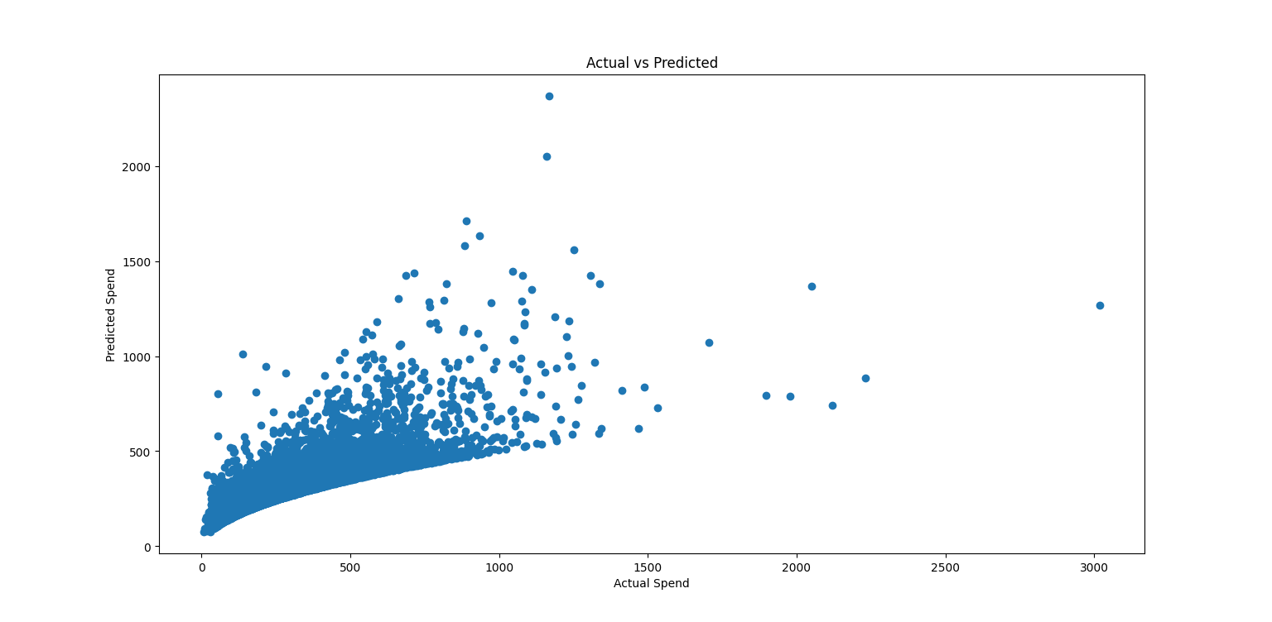
For K-Means Cluster I used Elbow Method for used to optimal number of clusters in K-Means by plotting WCSS against the number of clusters and selecting where the curve forms an elbow.
From import libraries of above tool I analyse that data of customer of each cluster and high and medium monthly spending, And correlation and Predictive Modelling vs actual spend.

Slide 6
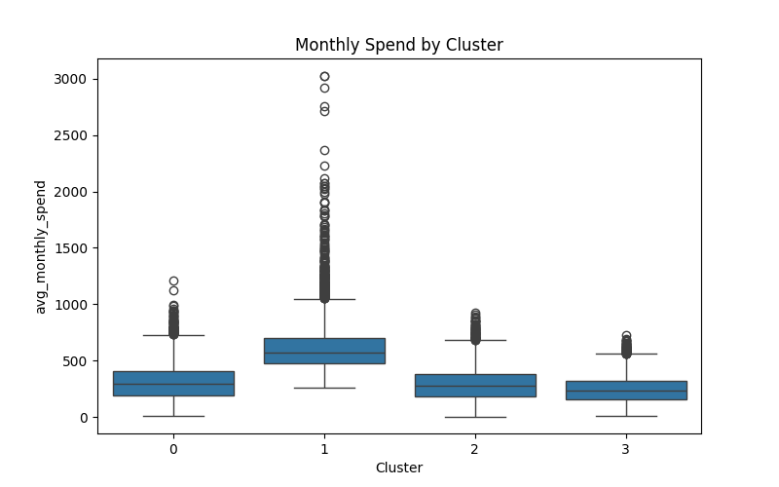
From this Graph which cluster spend more in monthly Cluster 1 Highest median spending, Many high-spending outliers (up to 3000+), Largest spending variation
Cluster 0 is medium spender and cluster 2 also lower medium spender with compared to cluster0. cluster 3 lowest spender in monthly.
This graph helps analyse purchase behaviour patterns because it shows how much customers in each cluster spend.

Slide 7
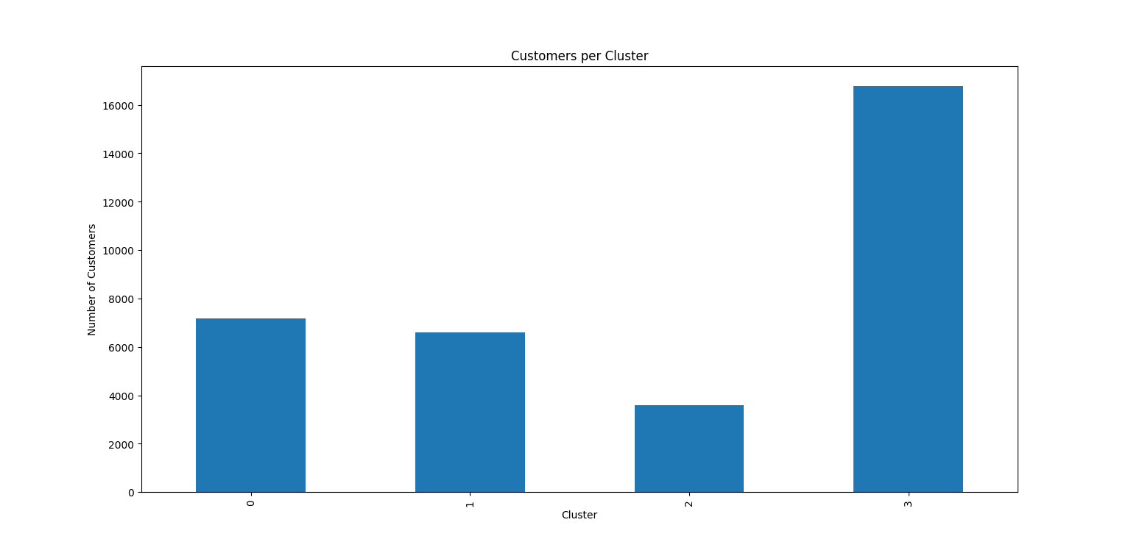
Key Insights
Insight 1
Cluster 3 contains nearly half of all customer, making it the dominant customer segment.
Insight 2
while Cluster 1 demonstrates the highest spending behaviour. This suggests that revenue is likely driven by a smaller group of high-value customers
Insight 3
Cluster 2 Occasional Customers Lower spending levels. Small customer population.
Insight 4
Marketing campaigns targeting cluster 3 for improve their sales and also in any occasional targeting cluster 2 for better marketing.

Slide 8
Recommendations
Focus on High-Value Customers (Cluster 1)
Introduce VIP membership and loyalty reward programs.
Offer personalized product recommendations.
Provide exclusive discounts and early access to new products.
Monitor this segment closely as it contributes the highest spending.
Upsell Regular Customers (Cluster 0)
Use cross-selling and bundle offers to increase basket size.
Recommend complementary products based on purchase history.
Encourage higher spending through targeted promotions.
Improve Engagement of Low-Spending Customers (Cluster 2)
Launch discount campaigns and special offers.
Send personalized email and SMS marketing campaigns.
Identify factors limiting spending and address them through targeted incentives.

Slide 9
Conclusion
Customer segmentation using K-Means clustering successfully identified four distinct customer groups with different spending behaviours. Cluster 1 represents the most valuable customers, exhibiting the highest monthly spending and strongest revenue potential. Cluster 3 forms the largest customer segment, contributing significantly through customer volume. Clusters 0 and 2 represent moderate and lower-spending customers, offering opportunities for upselling and engagement improvement. By implementing cluster-specific marketing, retention, and loyalty strategies, the business can improve customer satisfaction, increase revenue, and optimize marketing effectiveness.

Slide 10
Thank you
Q/A

